Slide 1
Architectural Design

Slide 2
Objectives
To introduce architectural design and to discuss its importance
To explain the architectural design decisions that have to be made
To introduce three complementary architectural styles covering organisation, decomposition and control
To discuss reference architectures are used to communicate and compare architectures

Slide 3
Topics covered
Architectural design decisions
System organisation
Decomposition styles
Control styles
Reference architectures

Slide 4
Software architecture
The design process for identifying the sub-systems making up a system and the framework for sub-system control and communication is architectural design.
The output of this design process is a description of the software architecture.

Slide 5
Architectural design
An early stage of the system design process.
Represents the link between specification and design processes.
Often carried out in parallel with some specification activities.
It involves identifying major system components and their communications.

Slide 6
Advantages of explicit architecture
Stakeholder communication
  Architecture may be used as a focus of discussion by system stakeholders.
System analysis
  Means that analysis of whether the system can meet its non-functional requirements is possible.
Large-scale reuse
  The architecture may be reusable across a range of systems.

Slide 7
Architecture and system characteristics
Performance
  Localise critical operations and minimise communications. Use large rather than fine-grain components.
Security
  Use a layered architecture with critical assets in the inner layers.
Safety
  Localise safety-critical features in a small number of sub-systems.
Availability
  Include redundant components and mechanisms for fault tolerance.
Maintainability
  Use fine-grain, replaceable components.

Slide 8
Architectural conflicts
Using large-grain components improves performance but reduces maintainability.
Introducing redundant data improves availability but makes security more difficult.
Localising safety-related features usually means more communication so degraded performance.

Slide 9
System structuring
Concerned with decomposing the system into interacting sub-systems.
The architectural design is normally expressed as a block diagram presenting an overview of the system structure.
More specific models showing how sub-systems share data, are distributed and interface with each other may also be developed.

Slide 10
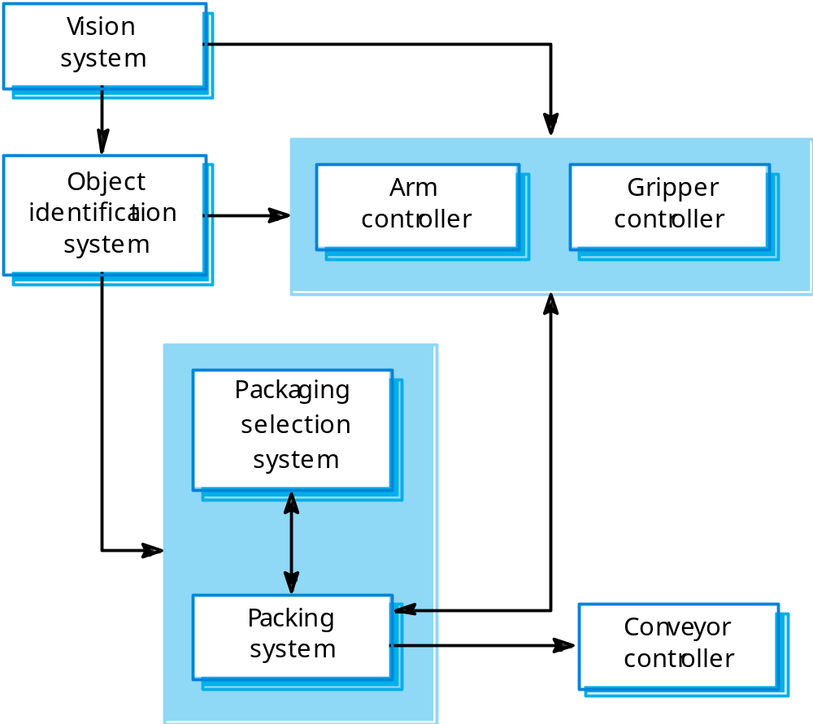
Packing robot control system

Slide 11
Box and line diagrams
Very abstract - they do not show the nature of component relationships nor the externally visible properties of the sub-systems.
However, useful for communication with stakeholders and for project planning.

Slide 12
Architectural design decisions
Architectural design is a creative process so the process differs depending on the type of system being developed.
However, a number of common decisions span all design processes.

Slide 13
Architectural design decisions
Is there a generic application architecture that can be used?
How will the system be distributed?
What architectural styles are appropriate?
What approach will be used to structure the system?
How will the system be decomposed into modules?
What control strategy should be used?
How will the architectural design be evaluated?
How should the architecture be documented?

Slide 14
Architecture reuse
Systems in the same domain often have similar architectures that reflect domain concepts.
Application product lines are built around a core architecture with variants that satisfy particular customer requirements.
Application architectures are covered in Chapter 13 and product lines in Chapter 18.

Slide 15
Architectural styles
The architectural model of a system may conform to a generic architectural model or style.
An awareness of these styles can simplify the problem of defining system architectures.
However, most large systems are heterogeneous and do not follow a single architectural style.

Slide 16
Architectural models
Used to document an architectural design.
Static structural model that shows the major system components.
Dynamic process model that shows the process structure of the system.
Interface model that defines sub-system interfaces.
Relationships model such as a data-flow model that shows sub-system relationships.
Distribution model that shows how sub-systems are distributed across computers.

Slide 17
System organisation
Reflects the basic strategy that is used to structure a system.
Three organisational styles are widely used:
  A shared data repository style;
  A shared services and servers style;
  An abstract machine or layered style.

Slide 18
The repository model
Sub-systems must exchange data. This may be done in two ways:
  Shared data is held in a central database or repository and may be accessed by all sub-systems;
  Each sub-system maintains its own database and passes data explicitly to other sub-systems.
When large amounts of data are to be shared, the repository model of sharing is most commonly used.

Slide 19
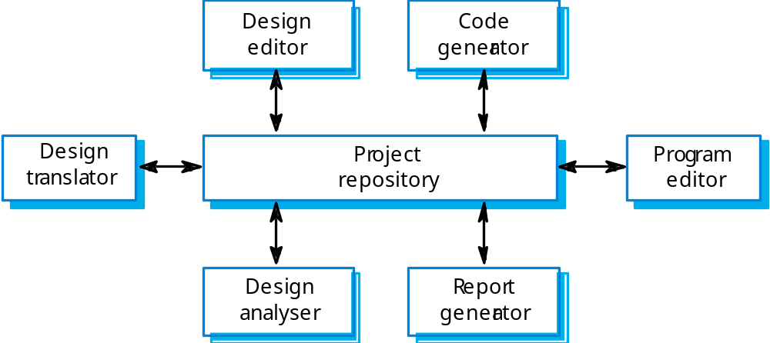
CASE toolset architecture

Slide 20
Repository model characteristics
Advantages
  Efficient way to share large amounts of data;
  Sub-systems need not be concerned with how data is produced Centralised management e.g. backup, security, etc.
  Sharing model is published as the repository schema.
Disadvantages
  Sub-systems must agree on a repository data model. Inevitably a compromise;
  Data evolution is difficult and expensive;
  No scope for specific management policies;
  Difficult to distribute efficiently.

Slide 21
Client-server model
Distributed system model which shows how data and processing is distributed across a range of components.
Set of stand-alone servers which provide specific services such as printing, data management, etc.
Set of clients which call on these services.
Network which allows clients to access servers.

Slide 22
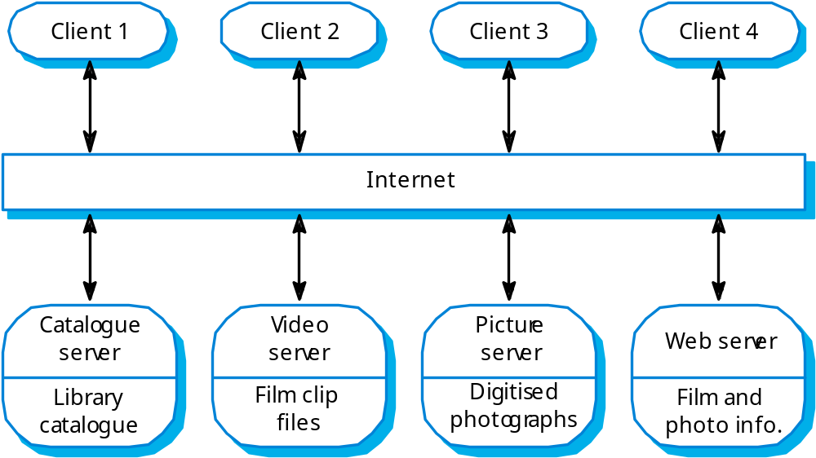
Film and picture library

Slide 23
Client-server characteristics
Advantages
  Distribution of data is straightforward;
  Makes effective use of networked systems. May require cheaper hardware;
  Easy to add new servers or upgrade existing servers.
Disadvantages
  No shared data model so sub-systems use different data organisation. Data interchange may be inefficient;
  Redundant management in each server;
  No central register of names and services - it may be hard to find out what servers and services are available.

